Slide 1
PIZZA SALES ANALYSIS
BY PUBALI MONDAL

Slide 2
INTRODUCTION
HELLO MYSELF PUBALI MONDAL
This is ppt showing pizza analysis using sql queries
I have used mysql workbench to get insights.

Slide 3


SQL QUERIES

Slide 4
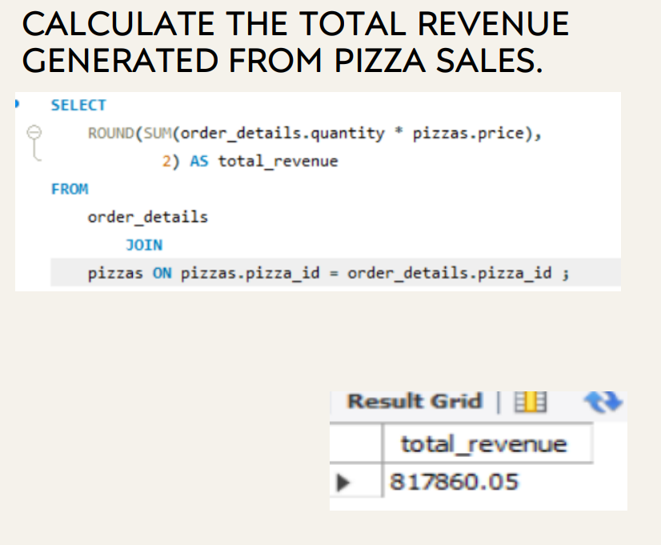

Slide 5

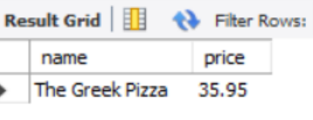
Identify the highest order pizza

Slide 6
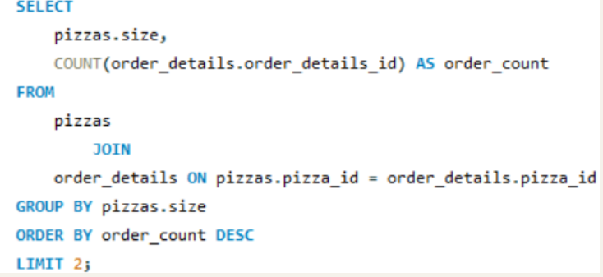
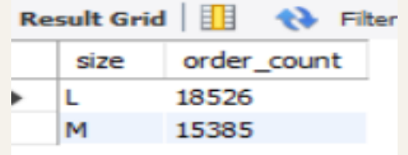
Most common pizza

Slide 7

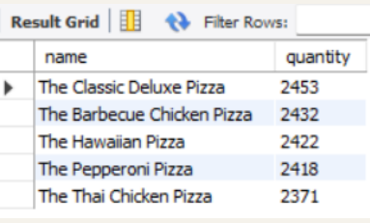
Top 5 most ordered pizzas along with their quantity

Slide 8
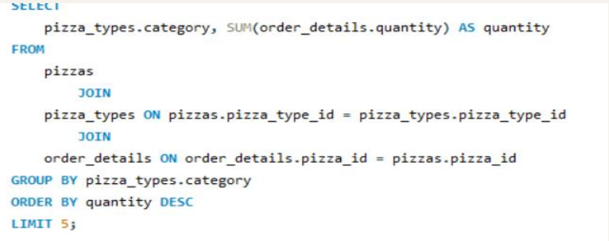
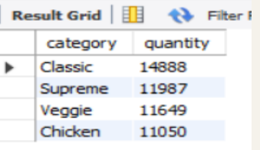
Quantity of each pizza

Slide 9

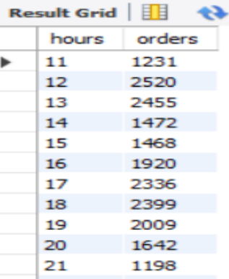
Distribution of orders by hours

Slide 10
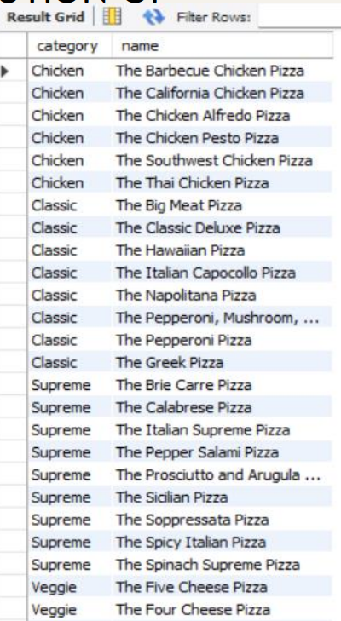

Category wise distribution of pizza

Slide 11
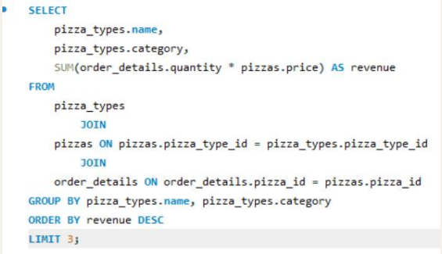
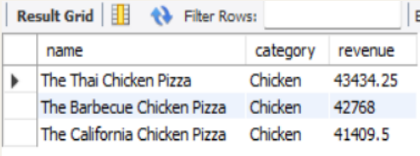
Top 3 pizzas ordered by revenue

Slide 12
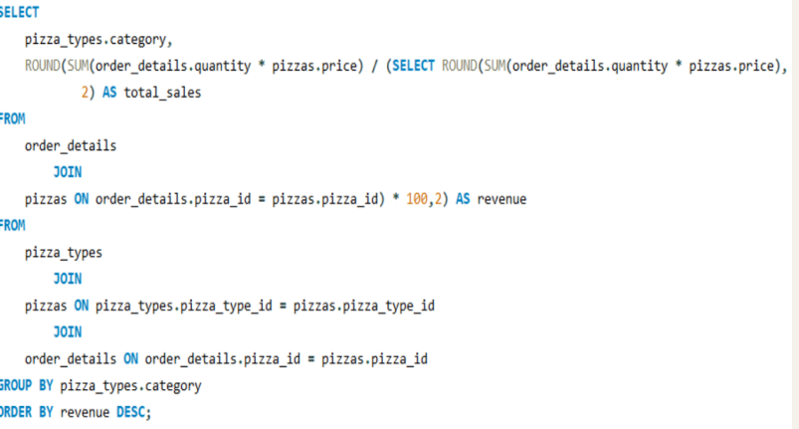
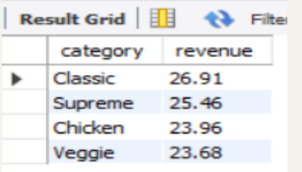
Percentage contribution

Slide 13
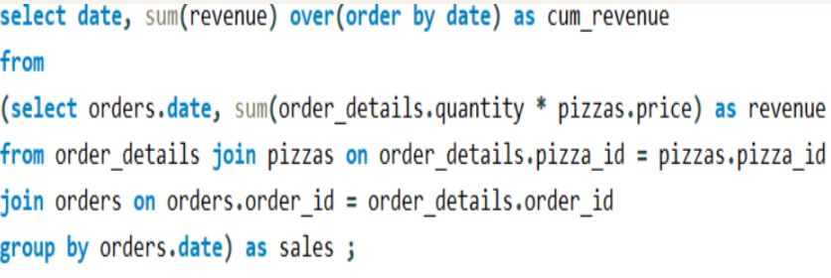
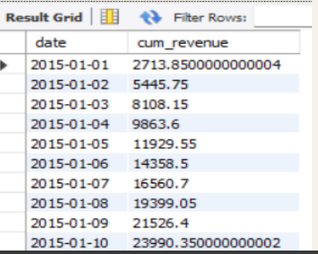
Cummulative revenue

Slide 14
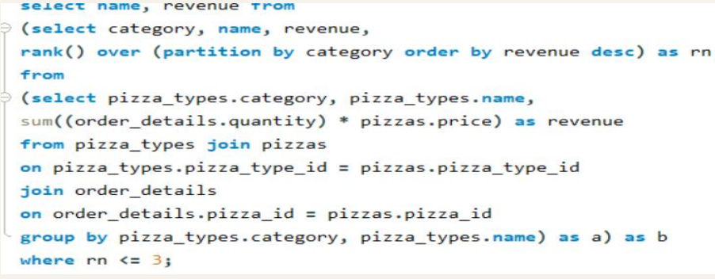
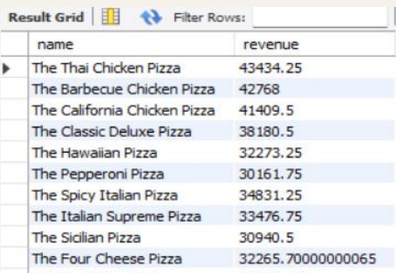
Top 3 most ordered pizza types based on revenue for each pizza category

